Slide 1
Compiler
Hybrid compiler:
Java language processors combine compiler and interpreter.
A Java source program may first be compiled into an intermediate form, then interpreted by a virtual machine.

Slide 2
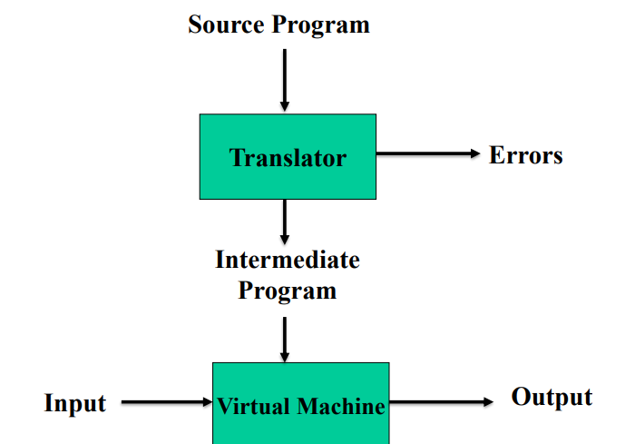
Compiler
Hybrid compiler:

